Slide 1

Tracking Air Pollution with Sentinel-5P Imagery: NO₂ Monitoring in Google Earth Engine
By:HAFSA FATHIMA
ROLL NO:24011D6014
BRANCH : ENVIRONMENTAL GEOMATICS

Slide 2
1. Introduction
Air pollution is one of the leading environmental risks to human health and ecosystems worldwide. Among the most harmful pollutants is nitrogen dioxide (NO₂), primarily emitted by vehicles, power plants, and industrial activities. Monitoring NO₂ is crucial for understanding air quality trends, identifying pollution sources, and informing policy.
This project aims to utilize Sentinel-5P satellite imagery in Google Earth Engine (GEE) to monitor and analyze NO₂ concentrations over selected urban areas. Sentinel-5P, operated by the European Space Agency (ESA), provides high-resolution atmospheric composition data, enabling near-real-time air pollution assessment on a global scale.

Slide 3
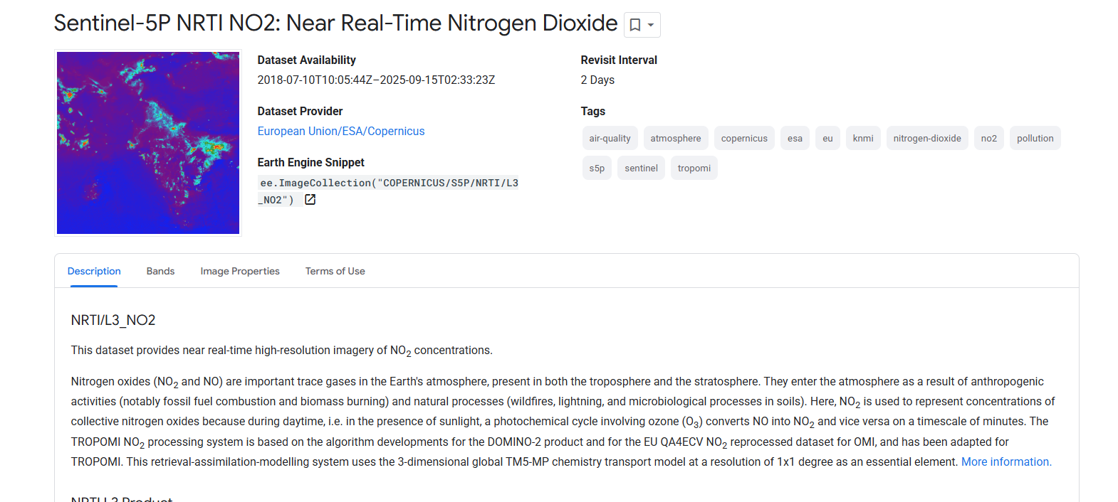
DATASET:SENTINEL 5P

Slide 4
2. Objectives
To acquire and visualize NO₂ concentration data from Sentinel-5P.
To track spatial and temporal variations in NO₂ across selected regions.
To identify pollution hotspots and seasonal patterns.
To demonstrate the effectiveness of Google Earth Engine for large-scale environmental monitoring.

Slide 5
3. Tools and Data Used
3.1 Sentinel-5P (TROPOMI) Data
Product: COPERNICUS/S5P/NRTI/L3_NO2
Variable: NO2_column_number_density
Resolution: ~7 x 3.5 km
Temporal Coverage: Daily from 2018 onwards
3.2 Google Earth Engine
A cloud-based platform for planetary-scale geospatial analysis. Key features include:
Access to satellite data catalogs
JavaScript and Python APIs
Built-in data visualization and analysis tools

Slide 6
4. Methodology
Selection of Area of Interest (AOI): Example cities: Delhi (India), Beijing (China), and Los Angeles (USA).
Time Period: NO₂ data analyzed for a full year (e.g., January 2023 to December 2023) to observe seasonal changes.
Data Processing Steps in GEE:
Import Sentinel-5P NO₂ dataset
Filter by date and AOI
Apply cloud masking if needed
Compute daily, monthly, and seasonal averages
Visualize using custom color palettes
Export statistics and images
Sample GEE Code Snippet:
var city = ee.Geometry.Point([77.1025, 28.7041]); // Delhi var no2 = ee.ImageCollection('COPERNICUS/S5P/NRTI/L3_NO2') .select('NO2_column_number_density') .filterBounds(city) .filterDate('2023-01-01', '2023-12-31') .mean(); var visParams = { min: 0.00002, max: 0.0005, palette: ['blue', 'green', 'yellow', 'orange', 'red'] }; Map.centerObject(city, 8); Map.addLayer(no2.clip(city.buffer(50000)), visParams, 'Annual Mean NO₂ - 2023');

Slide 7
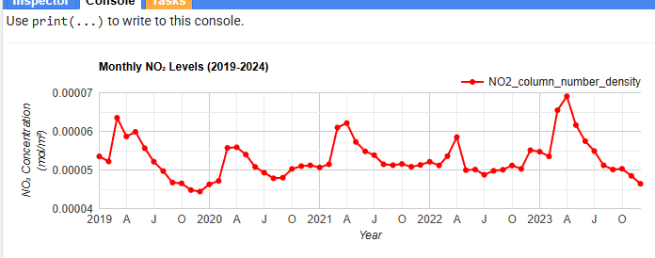
RESULTS

Slide 8
